Slide 1


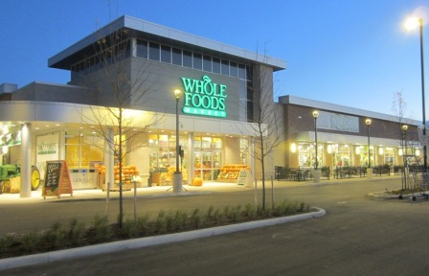
Whole Foods and MPM Food Equipment Group – a Partnership of Shared Values
Today: Midwest, Mid-Atlantic, Florida, and South offices
Tomorrow: North Atlantic region

Slide 2
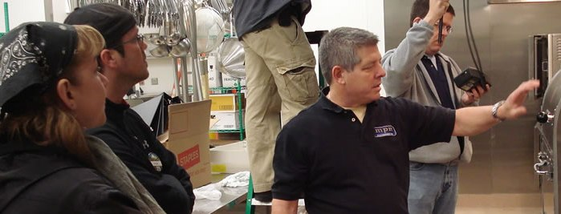
Whole Foods Partnership – Allies in
Serving Our Stakeholders
Treat Stakeholders With Respect, Fairness, and Integrity
Eliminate Unnecessary Costs to Help Ensure Best Possible Price
Communicate With Honesty, Timeliness
and Clarity

Slide 3
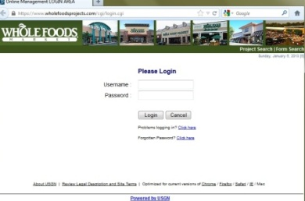
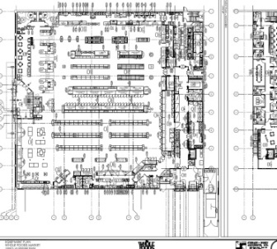
Right From the Beginning
Work directly by logging on to USGN
Consult Blueprint

Slide 4
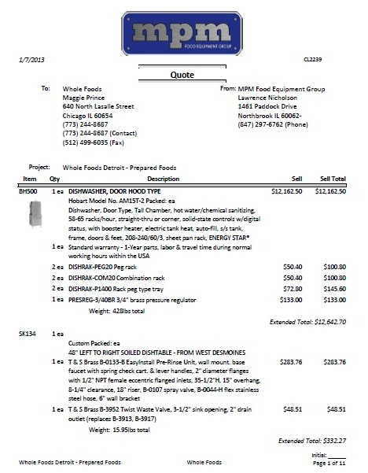
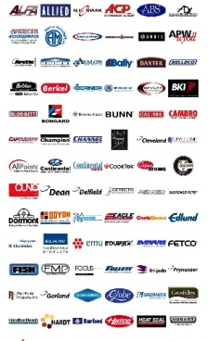
Quotation and Specification Sheets
Work with Equipment Buyers to Create Quote
MPM works with the Whole Foods design team to get the right equipment they need.
Great Manufacturers

Slide 5
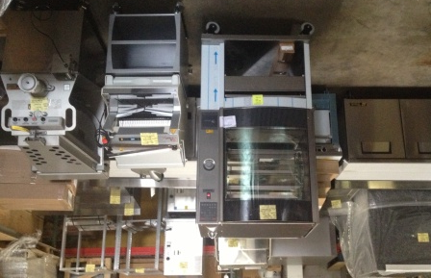
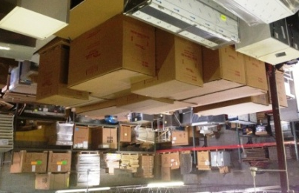
MPM Ensures the Right Equipment Before Delivering
Receive and Stage Equipment
MPM finds the equipment or fixture that fits your precise needs
Being a part of PRIDE gives MPM an advantage to be able to get every piece of equipment
Plus: We have great purchasing power, so we can get all the equipment at a great price.
Receive and stage all equipment
Eliminate the possibility of freight damage
Uncrate and assemble at MPM’s warehouse

Slide 6
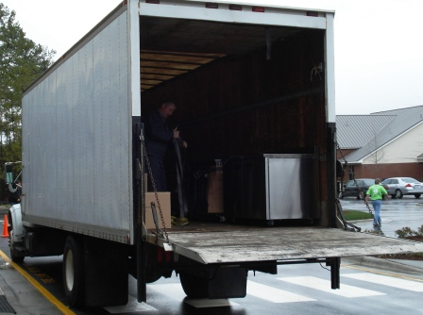
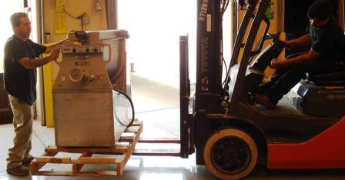
Load Equipment on MPM Trucks

Slide 7
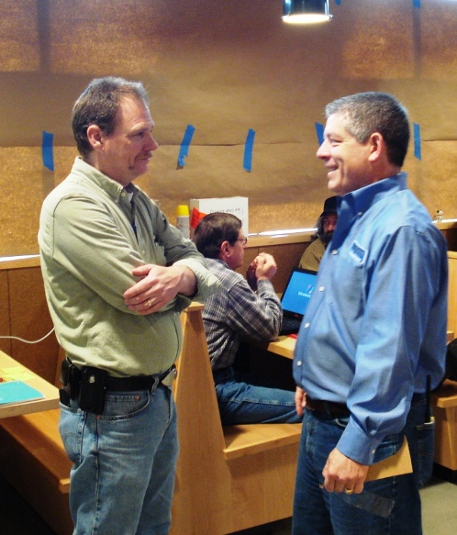
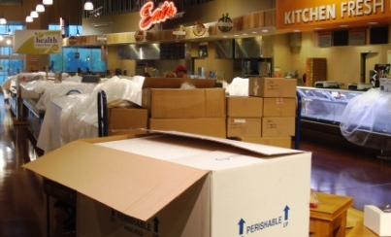
Project Managers Meet Truck at the Job Site

Slide 8
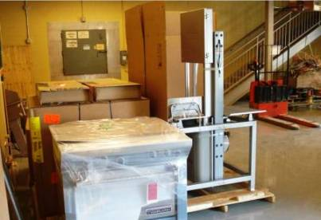
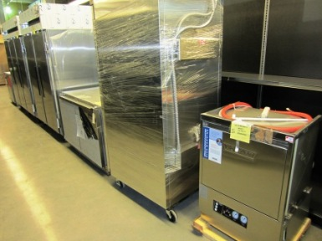
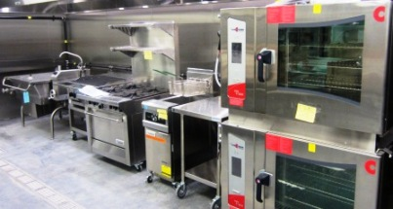
Setting new equipment in place as per equipment drawing

Slide 9
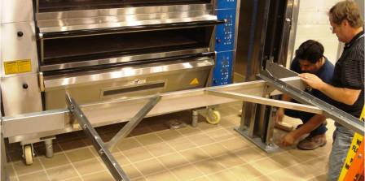
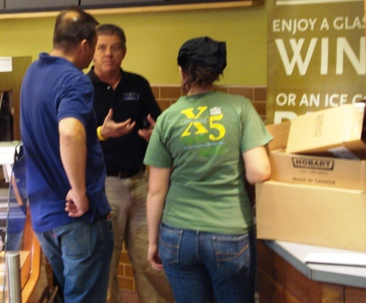
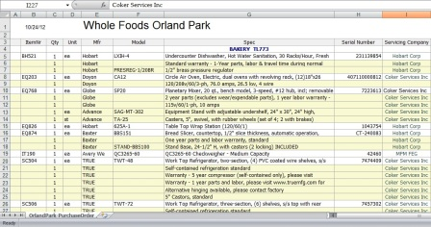
Setting Equipment, Starting It Up, Training, After-Sale Service
On-Site Project Management
After the unit is installed, MPM starts it up and sees that it works properly
MPM trains your team on the equipment
Team leaders have all of the information on the warranties and the service contacts of the equipment
If there is ever a problem, you can just call us. To the pros at MPM, service doesn’t stop at sale.

Slide 10
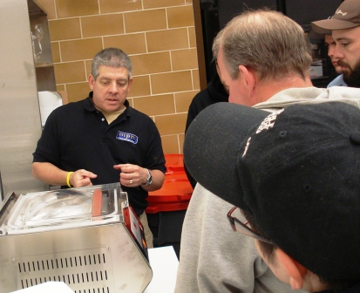
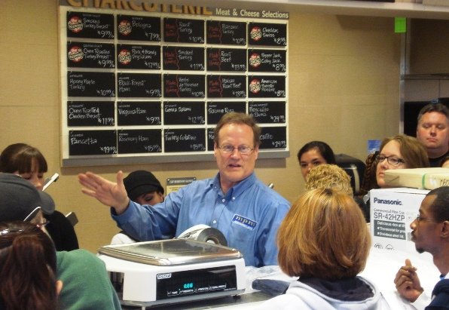
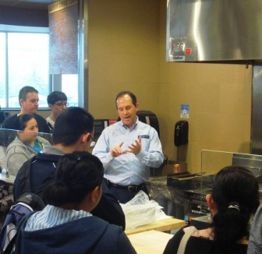
Training

Slide 11
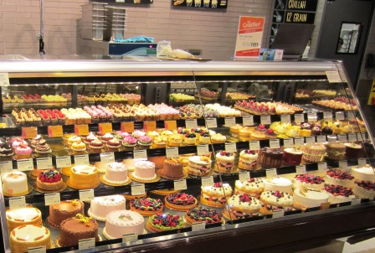
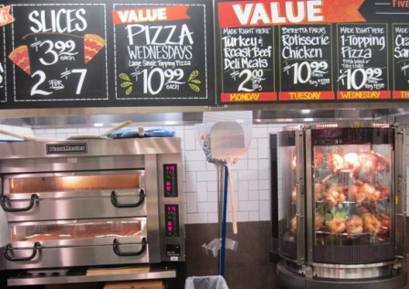
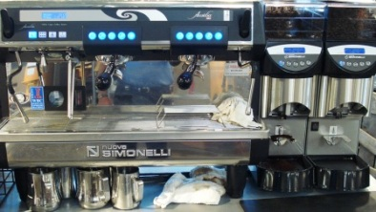
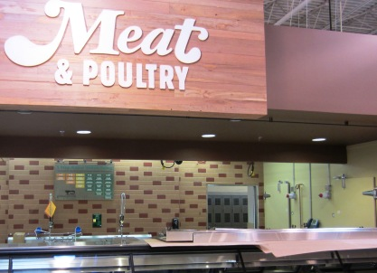
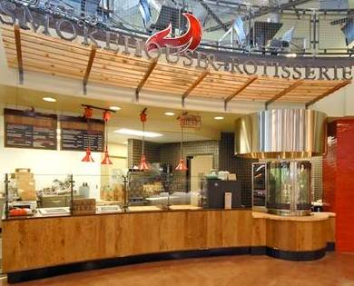
Perishable Departments
Bakery, General Store, Grocery, Meat, Prepared Foods, Produce, Seafood, Specialty Coffee

Slide 12

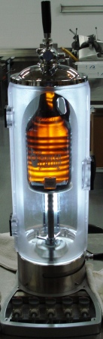

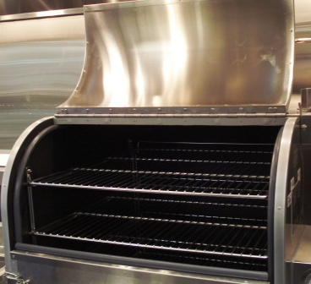
Additional Services by MPM
Innovation and Wise Environmental Practices
Preventative Maintenance Program
Energy Star Rebates
EnviroPure disposal systems
PizzaMaster Pizza Ovens
Fri-Jado Multisserie
Self-dispensing Ice Machines
Ole Hickory Smokehouses
Beer Growler Station
Portable Beer Systems

